Slide 1
Perubahan
Buku Panduan
Pelayanan Dana Kasih Pralaya
Notes:
This template can be used as a starter file to give updates for project milestones.
Sections
Right-click on a slide to add sections. Sections can help to organize your slides or facilitate collaboration between multiple authors.
Notes
Use the Notes section for delivery notes or to provide additional details for the audience. View these notes in Presentation View during your presentation.
Keep in mind the font size (important for accessibility, visibility, videotaping, and online production)
Coordinated colors
Pay particular attention to the graphs, charts, and text boxes.
Consider that attendees will print in black and white or grayscale. Run a test print to make sure your colors work when printed in pure black and white and grayscale.
Graphics, tables, and graphs
Keep it simple: If possible, use consistent, non-distracting styles and colors.
Label all graphs and tables.

Slide 2
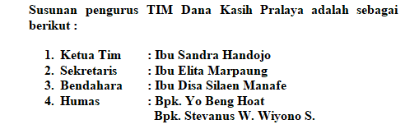
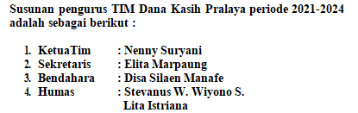
Judul :
BUKU PANDUAN PELAYANAN
TABUNGAN DANA KASIH PRALAYA
Judul :
BUKU PANDUAN PELAYANAN DANA KASIH PRALAYA
Notes:
What is the project about?
Define the goal of this project
Is it similar to projects in the past or is it a new effort?
Define the scope of this project
Is it an independent project or is it related to other projects?
* Note that this slide is not necessary for weekly status meetings

Slide 3
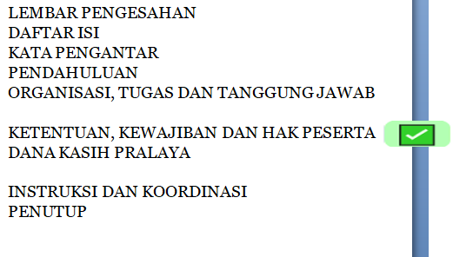
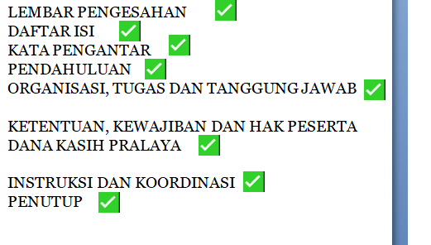
Isi Buku Panduan
Panduan Baru
Notes:
What is the project about?
Define the goal of this project
Is it similar to projects in the past or is it a new effort?
Define the scope of this project
Is it an independent project or is it related to other projects?
* Note that this slide is not necessary for weekly status meetings

Slide 4
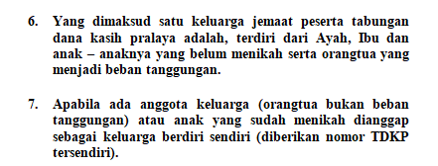
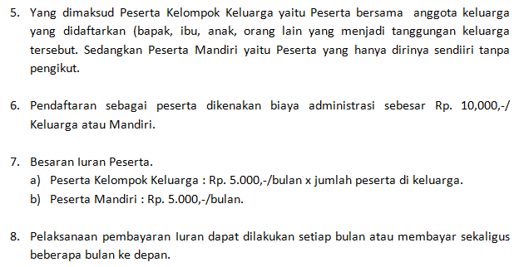
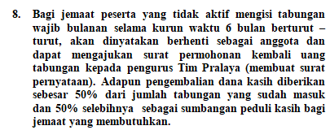
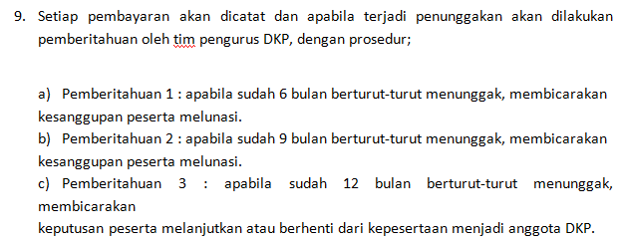
Poin Poin
Panduan Baru
Poin 1 s/d 4 Sama | Poin 1 s/d 4 tidak merubah arti Semua kata tabungan di hapus
 | Poin nomor 6 dan 7 di hapus dan diganti baru.
 | Poin 8 Diperbaiki Menjadi:
Notes:
* If any of these issues caused a schedule delay or need to be discussed further, include details in next slide.

Slide 5
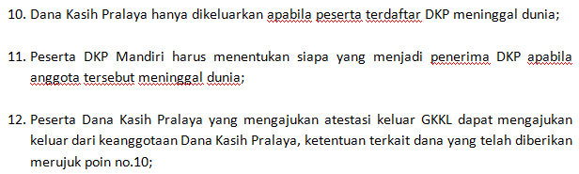
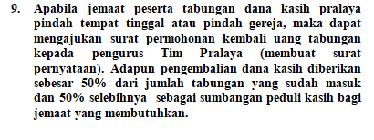


Tidak ada Pengembalian dana
Panduan Baru
Tambahan
Notes:
* If any of these issues caused a schedule delay or need to be discussed further, include details in next slide.

Slide 6
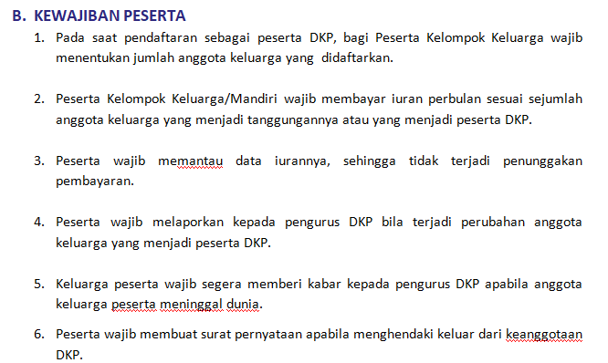
Panduan Baru
Kewajiban Peserta
Tambahan
Notes:
* If any of these issues caused a schedule delay or need to be discussed further, include details in next slide.

Slide 7
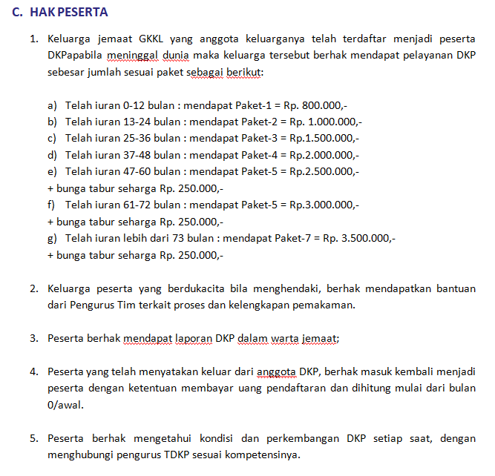
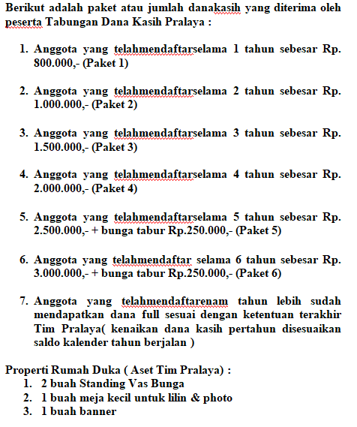
Hak Peserta
Panduan Baru
Notes:
* If any of these issues caused a schedule delay or need to be discussed further, include details in next slide.

Slide 8
Terima Kasih

